Slide 1
Life between humans and nature
Course Code: CSE-335
Course title: Computer Graphics
Khalid Mahmud
ID: 190321022
Notes:
Line spacing + Page numbers

Slide 2
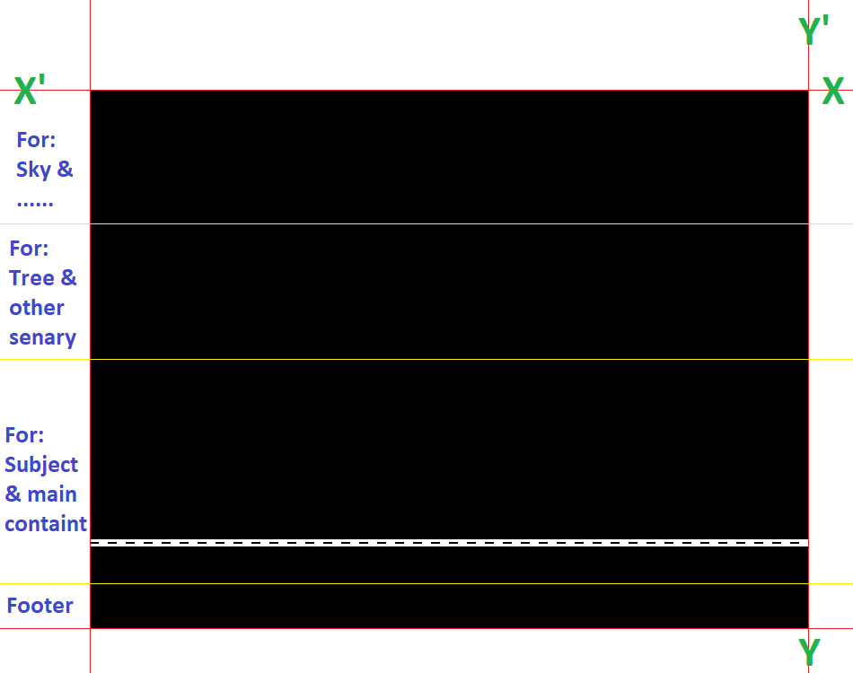
My Project:
Life between humans and nature:
In this project, I want to represent how humans dominate nature from the beginning, and day by day it’s losing its strength to survive. If this gets continues then nature will be destroyed entirely. Here all I want to remind us is that we are also part of nature.

Slide 3
Demo of my project:

Slide 4
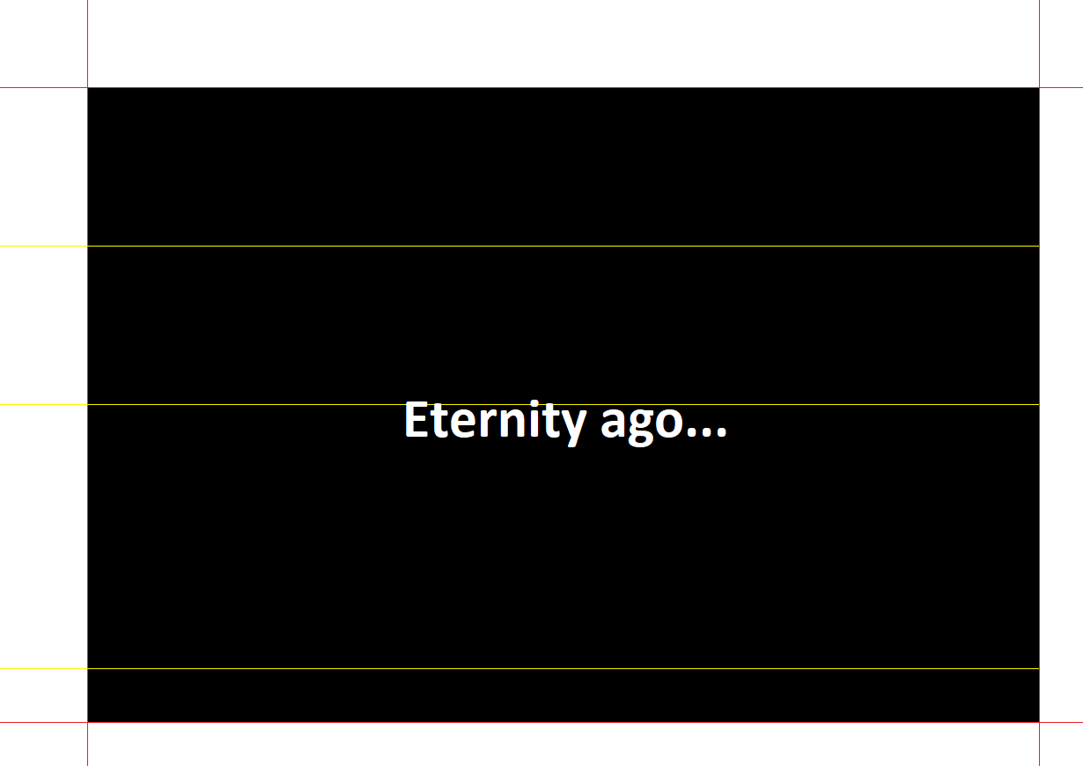

Slide 5
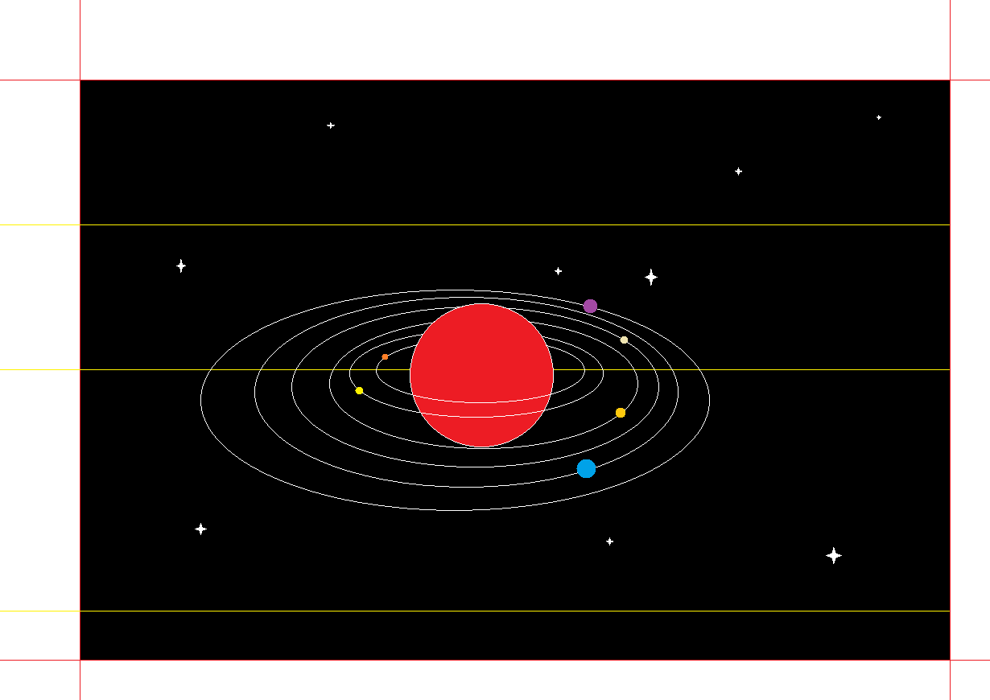

Slide 6
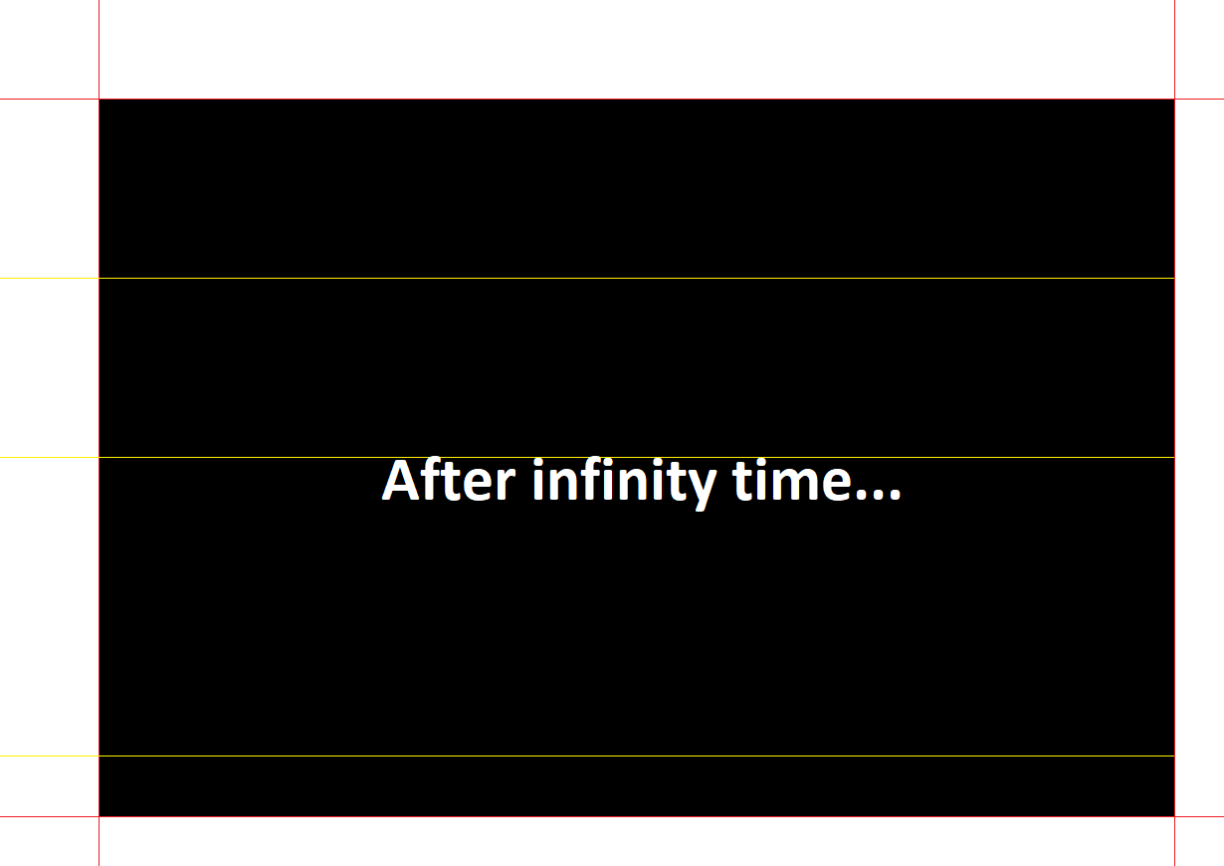

Slide 7
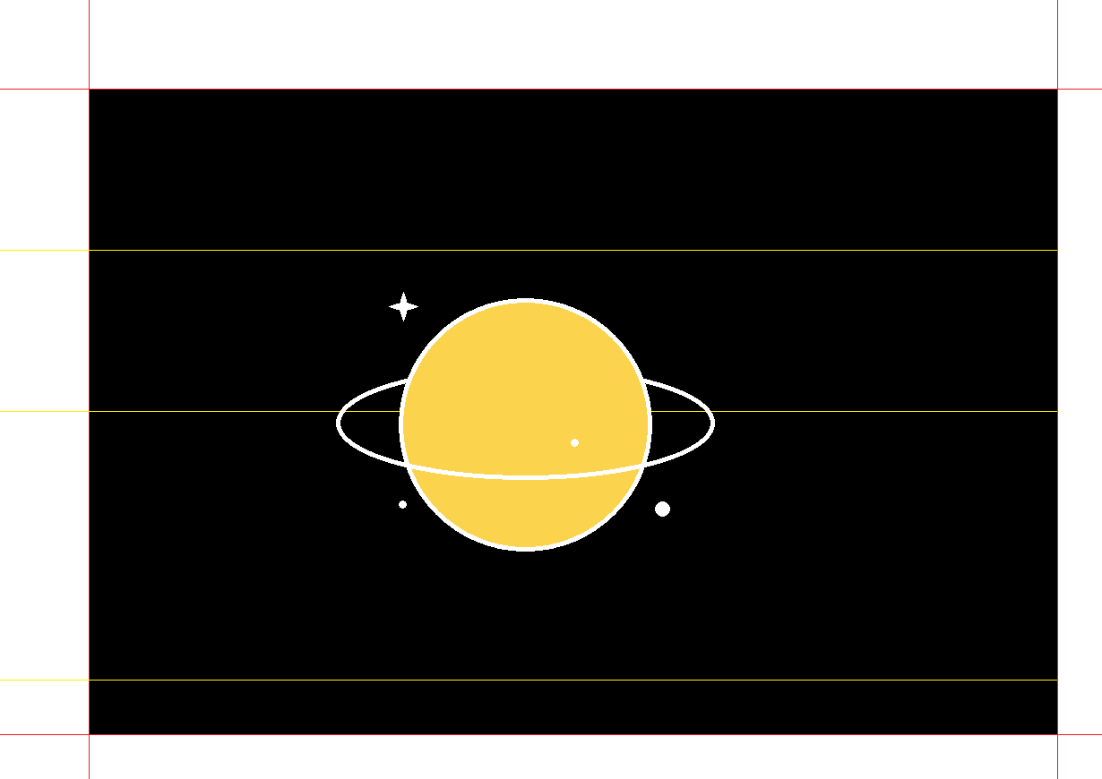

Slide 8


Slide 9


Slide 10


Slide 11


Slide 12


Slide 13
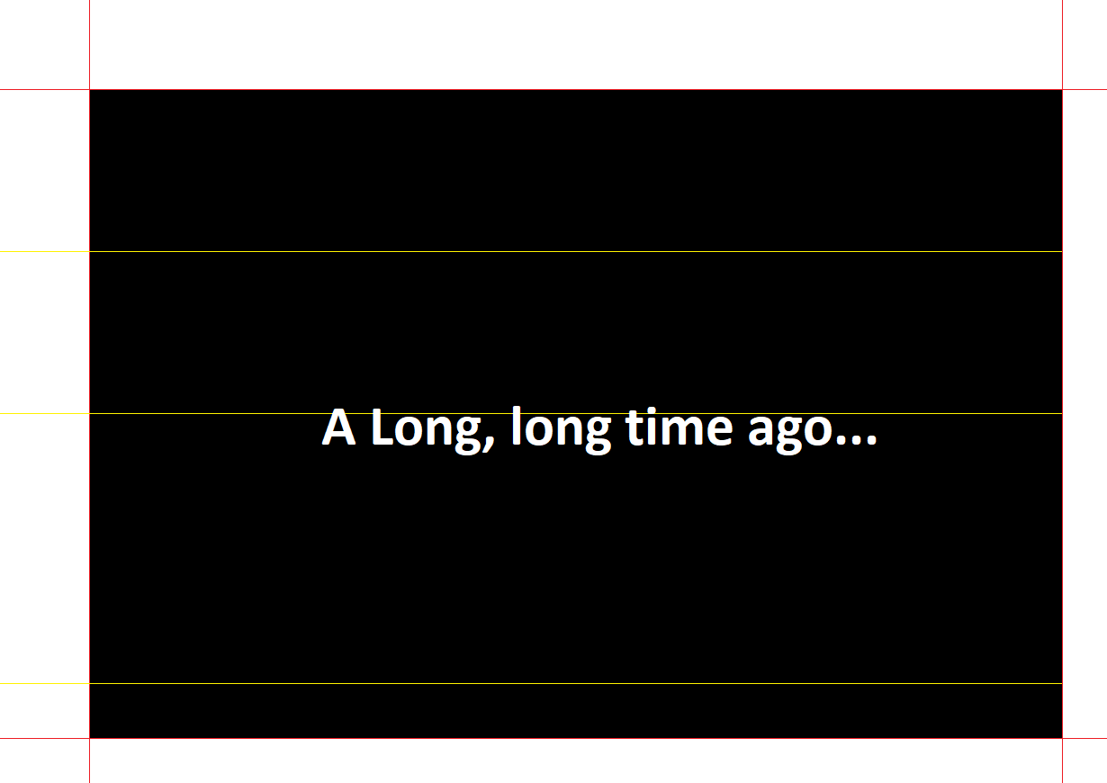

Slide 14
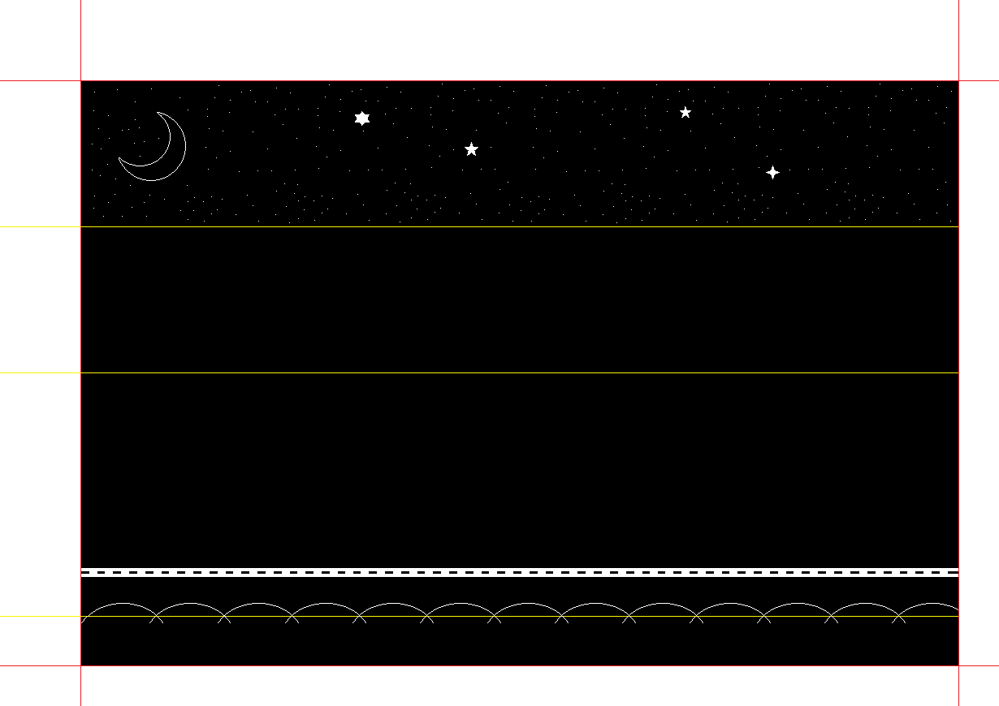

Slide 15
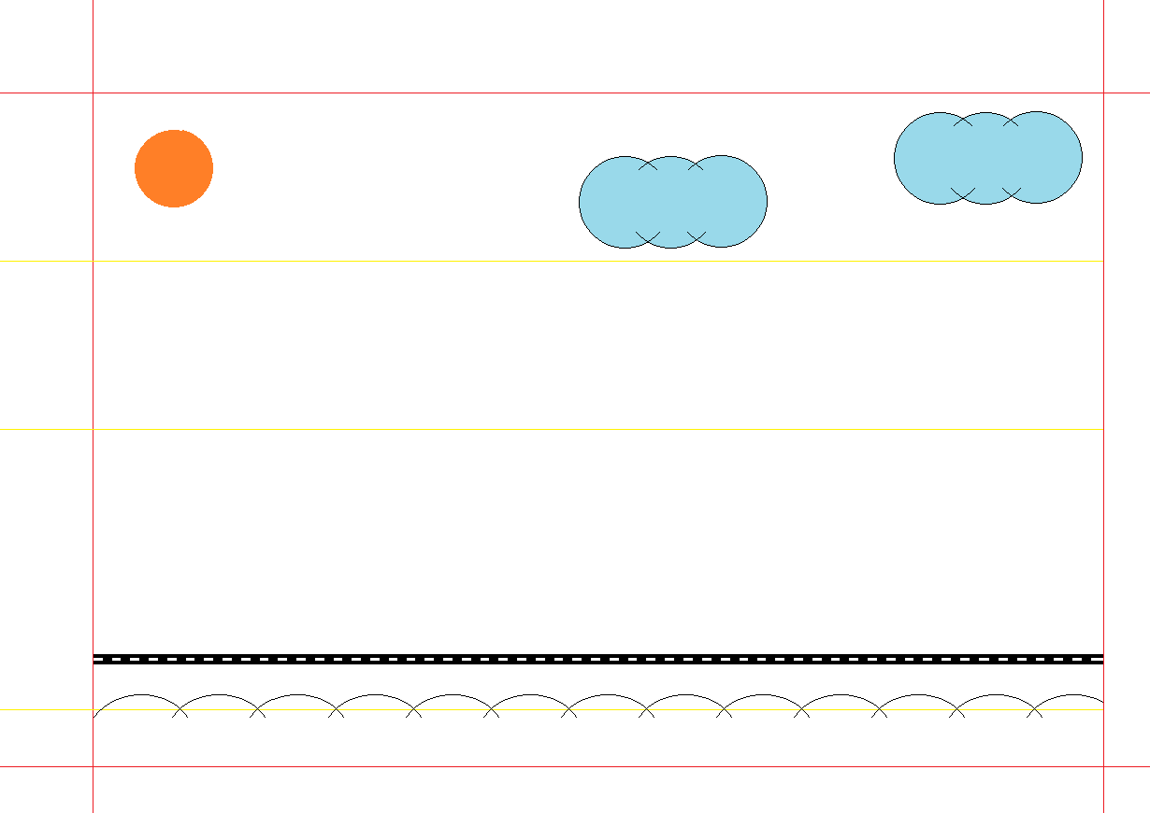

Slide 16
Thank you everyone

